Slide 1
Lean Practitioner: Process Improvement Report
Area & Process:
Start Date:
COUNTERMEASURE: DESCRIBE THE SOLUTION
Project Leader:
End Date:
CONCERN: DESCRIBE THE ISSUE
Describe the process issue and it’s impact.
Describe the solution that the team has identified
LOCATE: IDENTIFY THE SOURCE OF THE ISSUE
RESULTS: SHOW THAT THE ISSUE IS RESOLVED
Show, using a simple process flow map where the issue arises.
What evidence is there to show that the solution has worked?
UNDERSTAND: IDENTIFY THE CAUSE OF THIS ISSUE
Identify the most likely causes of the issue.
SIGN-OFF: RECOGNIZE THE TEAMS EFFORTS
Project Leader:
Process Owner:
Sign-off Date:

Slide 2
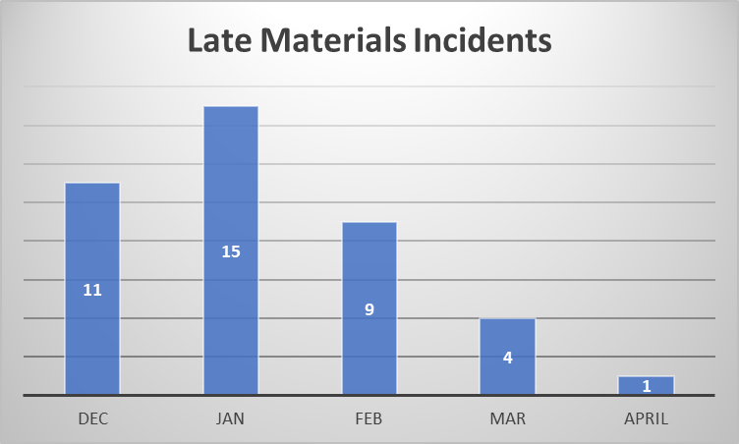
Lean Practitioner: Process Improvement Report
Area & Process: Engineering – Material ordering
Start Date: : 01/2/2018
COUNTERMEASURE: DESCRIBE THE SOLUTION
Project Leader: Joe Bloggs
End Date: 28/2/2018
Root Cause | Solution | Benefit | Cost | Risk | Responsible | Status
Materials not properly labelled | Designated location for allocated materials | Less errors 5 | Low 4 | Low 4 | Stores Supervisor | Complete
Materials not properly labelled | Place orders regardless of whether we have materials already available | No delays 5 | High 1 Waste of budget | Medium 3 run out of space | Solution deemed too expensive and wasteful – do not proceed | Hold
No backup for Supervisor to approve orders | Designate backup and give training/ access to system | Less waiting 4 | Medium 3 | Medium 3 | Supervisor/ Purchasing | Complete
CONCERN: DESCRIBE THE ISSUE
Issue: When students request that we order materials for their projects we sometimes don’t place the order on time or at all.
Impact: Students delayed in starting their project, impact on schedule in workshop resulting in pressure to get projects completed before submission deadline
LOCATE: IDENTIFY THE SOURCE OF THE ISSUE
Student requests material
Technician checks stores
Material available?
Yes
Order not placed
Issues in 2 places
Sometimes Technicians think material is available when it is allocated to another project
There are occasionly delays in getting order requests approved
RESULTS: SHOW THAT THE ISSUE IS RESOLVED
No
Solution implemented in late February.
All of the late orders received in March were due to issues in February.
One issue in April was caused due to a system issue which is now also fixed.
Contact Lecturer/ student with explanation
Submit order request
Order approval (Supervisor)
Approved?
Place order
UNDERSTAND: IDENTIFY THE CAUSE OF THIS ISSUE
Why do we think material is available when it is not?
- Material might not be clearly labelled
Why are materials not clearly labelled?
- Sometimes only one part in a batch of parts is labelled
Why do we only label one part?
- Too time consuming to label all parts. May have to take parts out of packaging to label them.
What action can we take to address this?
Create an area in materials stores for orders with are already allocated to a project so these are not mistakenly thought to be available or
Do not check stores – just submit the order assuming we don’t have the materials
Why are there delays getting orders approved?
- Only Supervisor can approve and he may not be available
Why is it that only one person can approve an order?
- No one else has approval authority in the system?
Why is no one else authorised to approve materials orders?
- The need for another person wasn’t recognised up to now
Issue significantly reduced – less complaints/schedule constraints
SIGN-OFF: RECOGNIZE THE TEAMS EFFORTS
Joe Bloggs
Project Leader: Joe Bloggs
What action can we take to address this?
Designate a Senior Technician to approve material orders in the absence of the Supervisor
Ann Other
Process Owner: Ann Other
Sign-off Date: 30/04/2018

Slide 3
Lean Practitioner: Process Improvement Report
Area & Process:
Start Date:
COUNTERMEASURE: DESCRIBE THE SOLUTION
Project Leader:
End Date:
CONCERN: DESCRIBE THE ISSUE
LOCATE: IDENTIFY THE SOURCE OF THE ISSUE
RESULTS: SHOW THAT THE ISSUE IS RESOLVED
UNDERSTAND: IDENTIFY THE CAUSE OF THIS ISSUE
SIGN-OFF: RECOGNIZE THE TEAMS EFFORTS
Project Leader:
Process Owner:
Sign-off Date:

Slide 4
Team Action Tracker
ACTION | DESCRIPTION | RESPONSIBLE | TARGET DATE | STATUS
Lean Practitioner projects can be delivered by teams of 2-4 people. If you are delivering your project as part of a team please complete this action tracker to demonstrate what each team member contributed to the project.

Slide 5
Pre-submission Checklist
ACTION | COMPLETE?
All sections of the A3 complete?
Visuals used rather than text, where appropriate (e.g., process map in Locate section, graph in Results section )
Consistent formatting throughout, e.g., text font and size, content alignment
Clear connection between all Sections (telling the project Story)
Appropriate use of tools – not including tools that do not influence the project
Clear, easy to follow, process map using correct format (process steps, diamond shape decisions, arrows,etc)
When using a Fishbone diagram, applied cause screen across all points
When using a Fishbone diagram, applied cause screen across all points
Clear before and after (Concern and Results sections)
Signatures (e-signature is fine) provided to indicate sign off by project (or project team members) and process owner
Please make sure you have completed each of the above steps before submitting your final report

